Slide 1

AI IN INSURANCE INDUSTRY
Using machine learning to improve insurance risk predictions

Slide 2
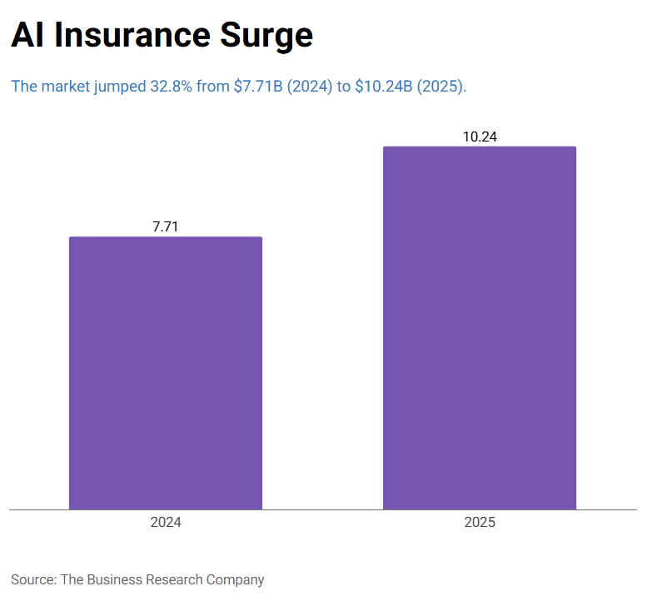

Slide 3
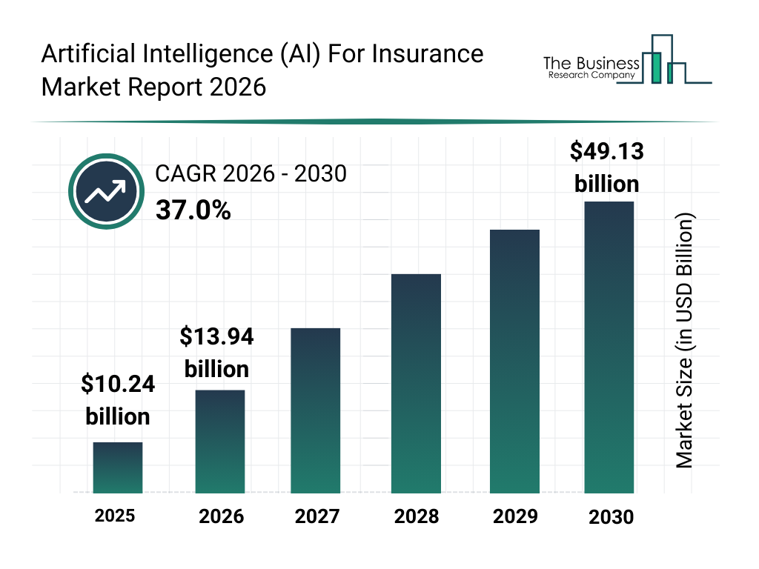

Slide 4
INTRODUCTION
Insurance companies rely heavily on accurate risk prediction to identify potential customers, make marketing easier, and reducing the chances of loosing money.
Traditionally, actuarial models such as logistic and Probit regression have been widely used because they are interpretable and statistically solid.
However because of the rapid growth of data, insurance companies have started to shift from these traditional methods to machine learning techniques that can capture more complex and nonlinear relationships which traditional models may miss
Therefore, this study investigates whether modern machine learning techniques—specifically Random Forest and XGBoost—can outperform traditional actuarial models in predicting customer interest in vehicle insurance.
In addition to comparing predictive performance, the study also analyzes which variables are most influential across models.
This helps insurance companies to identify what influences customers’ decisions and what factors encourage them to purchase insurance.”

Slide 5

Objective of the study
Compare traditional actuarial models (Logistics & Probit) with Machine Learning models (Random Forest & XG-Boost)
Evaluate predictive performance
Identify key variables influencing insurance purchase decisions

Slide 6
Data description
The dataset used in this study was obtained from Kaggle's Health Insurance Cross Sell Prediction dataset, which contains customer demographic information, vehicle characteristics, and previous insurance history used to predict interest in vehicle insurance products.
The dataset consist of 381109 observations, 10 predictor variables and a Binary response variable

Slide 7
Variable | Type | Description
Gender – predictor variable | Categorical | Gender of the customer
Age – predictor variable | Numeric | Age of the customer
Driving_License – predictor variable | Categorical-Binary(0 or 1) | 0 : Customer does not have DL, 1 : Customer already has DL
Region_Code – predictor variable | Categorical | Unique code for the region of the customer
Previously_Insured – predictor variable | Categorical | 1 : Customer already has Vehicle Insurance, 0 : Customer doesn't have Vehicle Insurance
Vehicle_Damage – predictor variable | Categorical | 1 : Customer got his/her vehicle damaged in the past. 0 : Customer didn't get his/her vehicle damaged in the past.
Annual_Premium – predictor variable | Numeric | The amount customer needs to pay as premium in the year
Policy_Sales_Channel – predictor variable | Numeric | Anonymized Code for the channel of outreaching to the customer ie. Different Agents, Over Mail, Over Phone, In Person, etc.
Vintage – predictor variable | Numeric
Vehicle_Age – predictor variable | Categorical | Age of the Vehicle
Response – Target Variable | Categorical-Binary(0or1) | 1 : Customer is interested, 0 : Customer is not interested

Slide 8
Research methodology
The research follows a structured process, starting with data collection from “Kaggle”. The dataset contains information for insurance customers, including demographic characteristics, vehicle information, and insurance history.
These predictor variables are used to predict whether a customer will purchase vehicle insurance.
The dataset will undergo EDA (exploratory data analysis), preprocessing, including feature selection and data cleaning to ensure reliability, consistency and accuracy.
The core of this study involves using 2 traditional models – Logistic Regression & Probit Regression vs 2 Machine Learning models – Random Forest & X-GBoost on the prepared dataset.

Slide 9
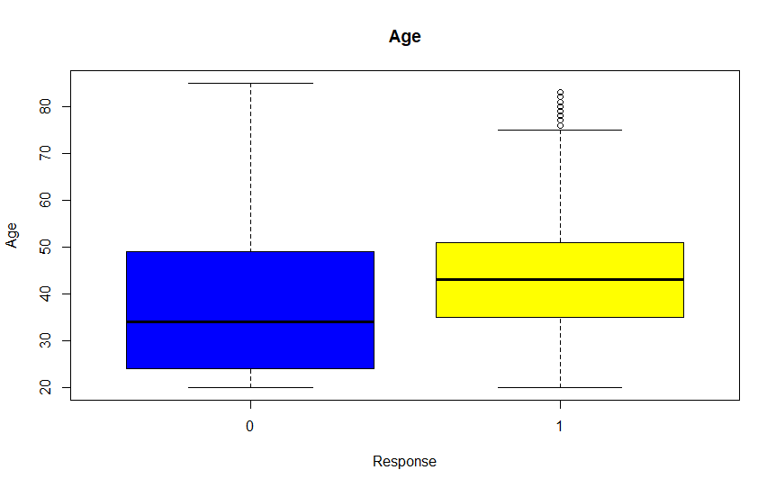
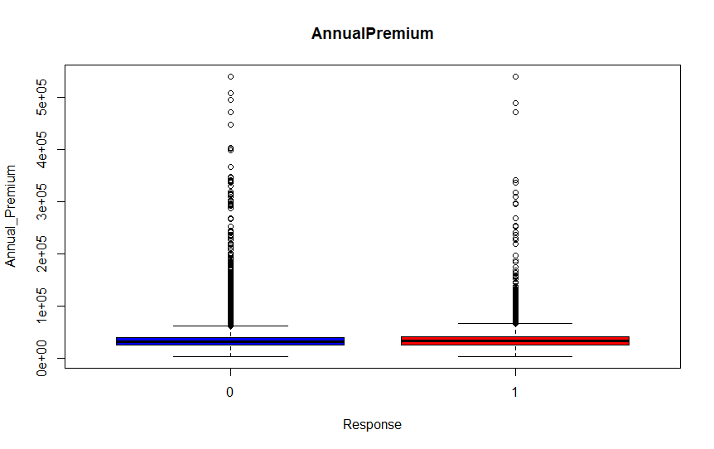
Research methodology Exploratory Data analysis
Boxplots showing relationship between target outcome and quantitative features

Slide 10
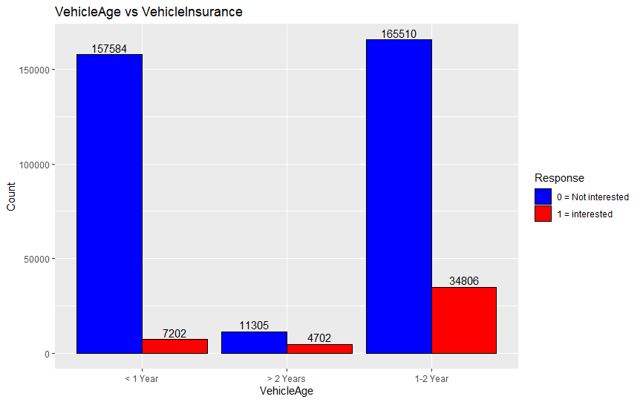
Research methodology Exploratory Data analysis
Side by side Barcharts showing relationship between target outcome and categorical features
Insurance Customer Interest rates
<1year = 7202 /(7202+157584) = 4.37%
1-2years = 34806/(34806+165510) = 17.38%
>2years = 4702/(4702+11305) = 29.37%

Slide 11
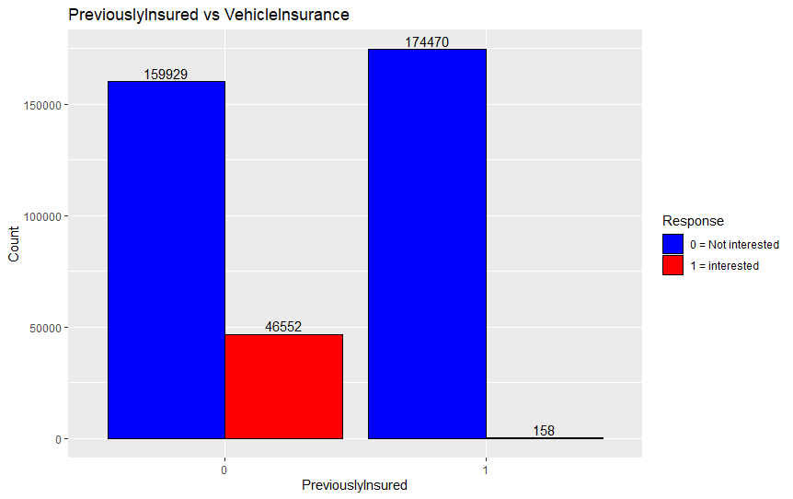
Research methodology Exploratory Data analysis
Insurance Customer Interest Rates
Previously insured = 158 / (158+174470) = 0.09%
Not previously insured = 46552 / (46552+159929) = 22.55%

Slide 12
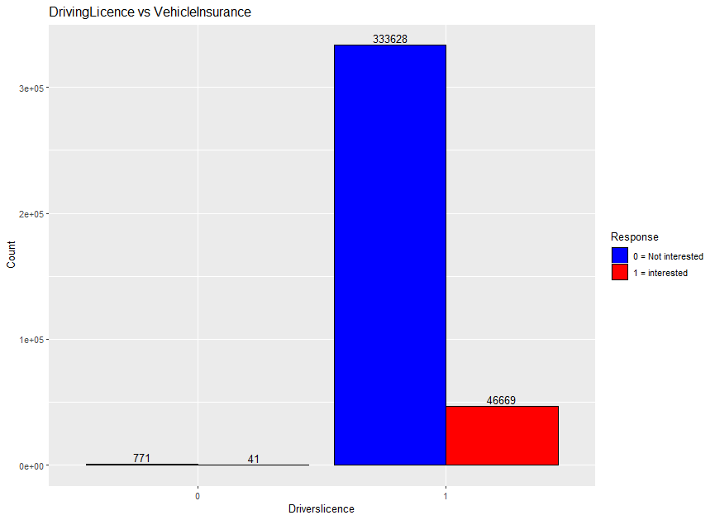
Research methodology Exploratory Data analysis
Insurance Customer Interest Rates
License = 41 / (41+771) = 5.05%
No license = 46669 / (46669+333628) = 12.27%

Slide 13
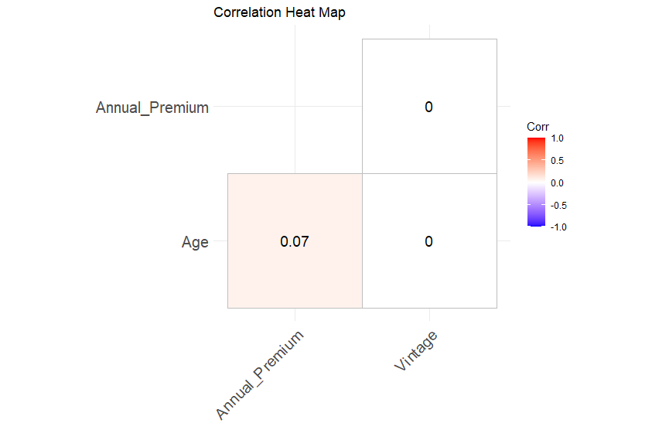
Research methodology Exploratory Data analysis
Correlation heatmap to show how quantitative predictors are related

Slide 14
RESEARCH RESULTS Evaluation Metrics (Prediction Performance)
4. ROC Curve (Receiver Operating Characteristic)
A graph showing:
True Positive Rate (Recall) vs False Positive Rate
It evaluates performance across all thresholds, not just one
5. AUC (Area Under the Curve)
A single number summarizing the ROC curve
Range:
0.5 = random model
1.0 = perfect model
Accuracy = (TP+TN) / (TP+TN+FP+FN)
Recall(Sensitivity) = TP / (TP+FN)
Specificity = TN / (TN+FP)

Slide 15
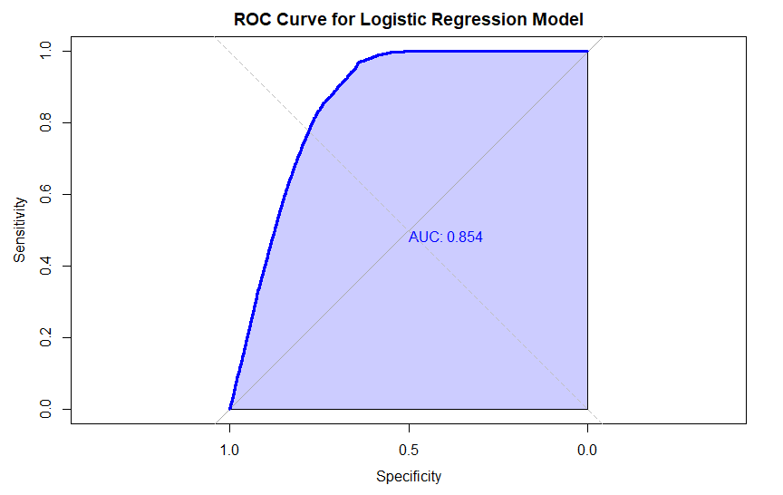
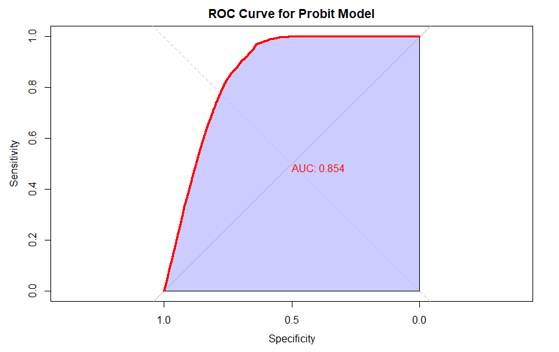
RESEARCH RESULTS
ROC (Receiver Operating Characteristic) Curves– Showing how well the model distinguishes between customers who are interested and not interested

Slide 16
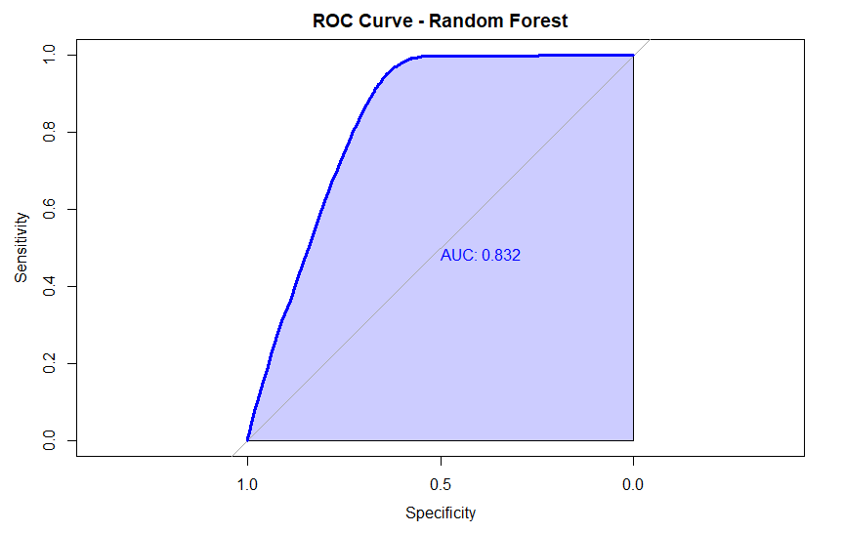
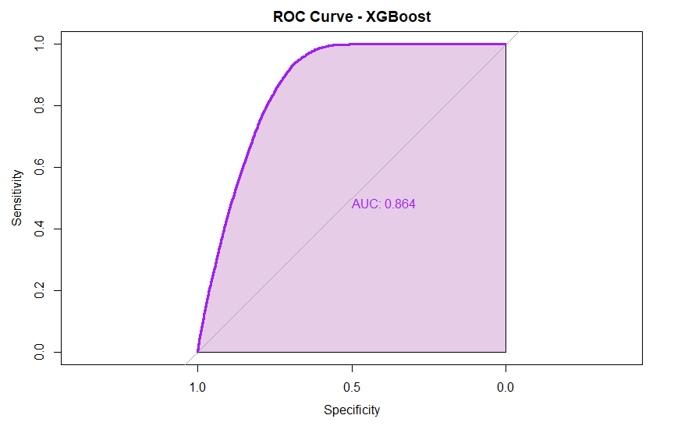
RESEARCH RESULTS

Slide 17
RESEARCH RESULTS
Confusion Matrix Metrics (Side-by-Side Comparison)
Discussion
Model | Sensitivity(Recall) | Specificity | Balanced Accuracy
Logistic Regression | 0.7833 | 0.750 | 0.791
Probit Regression | 0.832 | 0.751 | 0.792
Random Forest | 0.950 | 0.638 | 0.794
XGBoost | 0.934 | 0.688 | 0.811
Sensitivity (Recall): Most important for detecting potential insurance buyers. Random Forest has the highest sensitivity (95%), making it best for identifying high-value customers.
Balanced Accuracy: Since the data was imbalanced, balanced accuracy was the best to use for model evaluation. XGBoost slightly outperforms others (81.1%), showing strong performance across both classes.
Specificity: Probit Regression is best at avoiding false positives but misses more buyers.

Slide 18
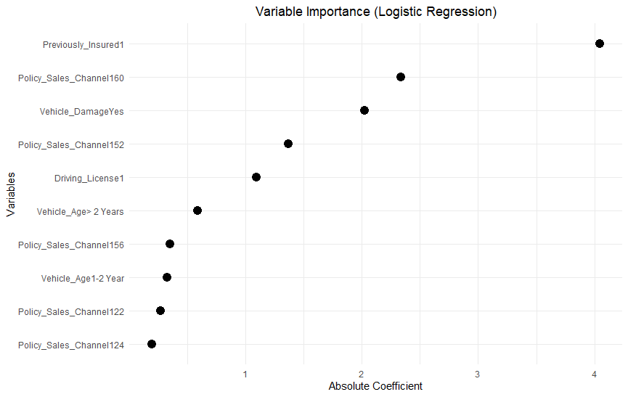
RESEARCH RESULTS Variable Importance for Logistic Regression Model
Previously_insured variable is the most influential variable to outcome prediction

Slide 19
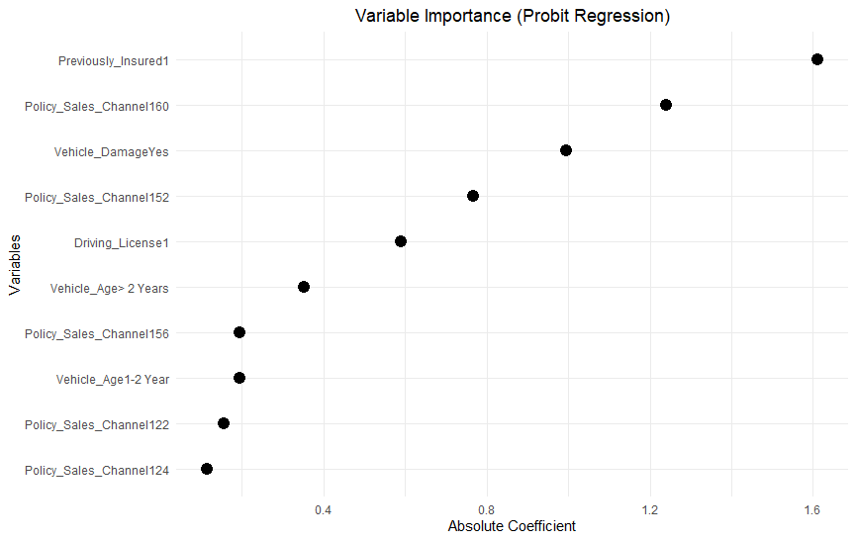
RESEARCH RESULTS Variable Importance for Probit Regression Model
Previously_insured variable is the most influential variable to outcome prediction

Slide 20
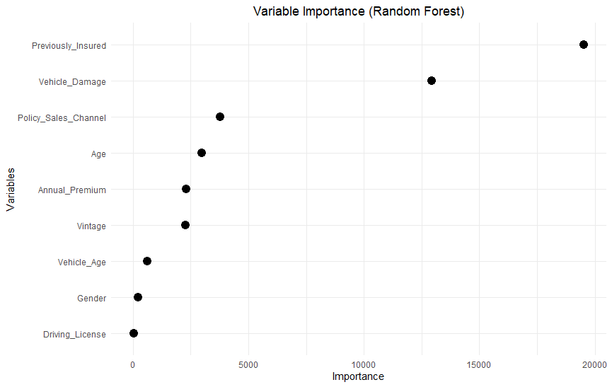
RESEARCH RESULTS Variable Importance for Random Forest Model
Previously_insured variable is the most influential variable to outcome prediction

Slide 21
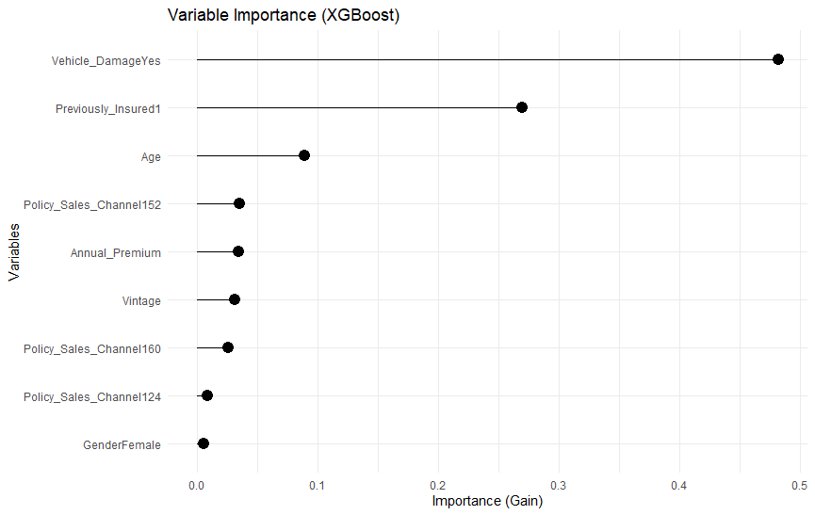
RESEARCH RESULTS Variable Importance for XGBOOST Model
Vehicle damage variable is the most influential variable to outcome prediction

Slide 22
conclusion
After completing the analysis, a comparison was conducted between Logistic Regression (traditional actuarial model) and Machine Learning models (Random Forest and XGBoost) to determine the best model for predicting whether customers are interested in purchasing vehicle insurance.
Evaluation metrics used included sensitivity (recall), precision, balanced accuracy, and ROC-AUC to assess overall model performance.
Sensitivity (recall) was identified as the most important metric, as the goal is to correctly identify potential insurance buyers.
The Machine Learning models outperformed the traditional model, with Random Forest achieving the highest sensitivity, followed closely by XGBoost.
Overally, Previously Insured, Policy Sales Channel , and Vehicle Damagewere the most influential variables.

Slide 23

Limitations
Data was imbalanced there was a larger proportion of non-buyers than buyers, which can affect model prediction.
The data set from Kaggle may not be a full representation of the real world data for vehicle insurance.
Only one traditional and two machine learning models were tested, therefore other models might achieve better results.
Although Machine Learning models results in higher predictability and can handle large diverse datasets, they are not as good for interpretability as traditional models like Logistic regression.

Slide 24
References
Kaggle Dataset: Vehicle Insurance Customer Response Prediction Dataset
Hanafy, M., & Ming, R. (Year). Machine Learning Approaches for Auto Insurance Big Data
Nyström, L., & Witt, O. (Year). Predicting Vehicle Insurance Premiums Using Linear Regression, XGBoost, and Neural Networks: A Comparative Study of Predictive Power
Rawat, S., Rawat, A., Kumar, D., & Sabitha, A. S. (Year). Application of machine learning and data visualization techniques for decision support in the insurance sector

Slide 25

Thank You
SIMBARASHE NGONYAmA

Slide 26
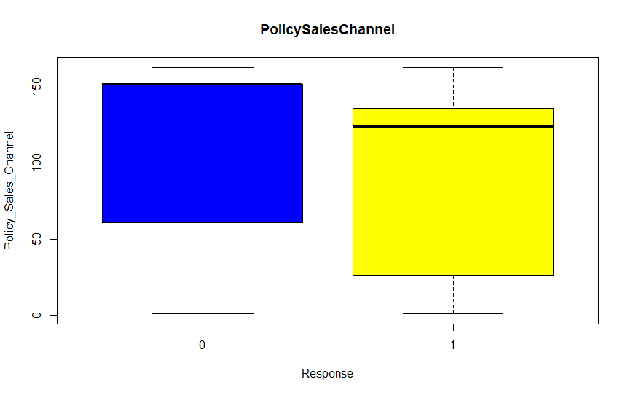
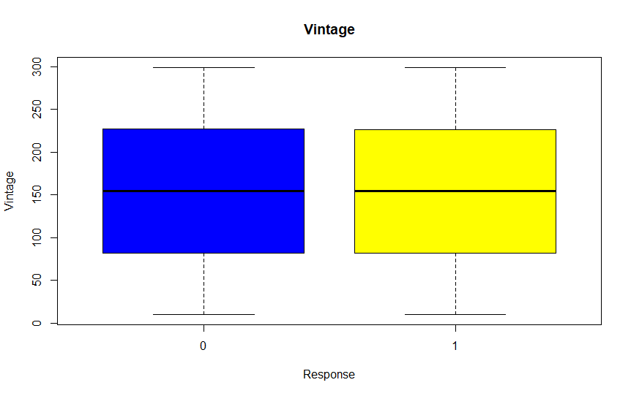
Research methodology Exploratory Data analysis
Boxplots showing relationship between target outcome and quantitative features

Slide 27
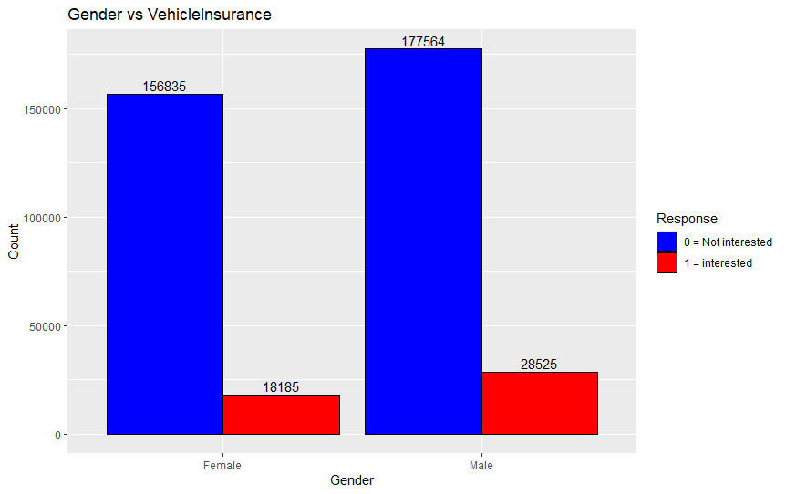
Research methodology Exploratory Data analysis
Interest Rates
Female = 18185 / (18185+156835) = 10.39%
Male = 28525 / (28525+177564) = 13.84%

Slide 28
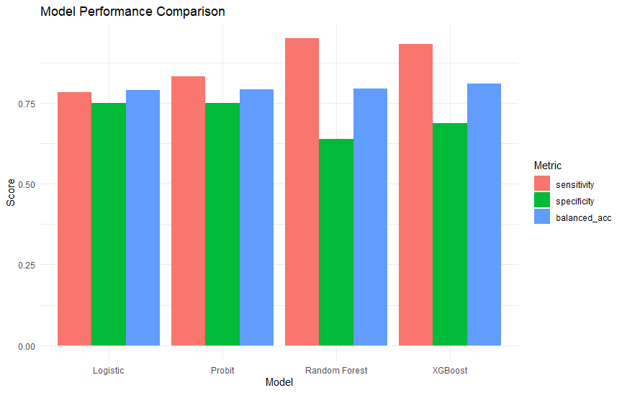
RESEARCH RESULTS

